Slide 1

Image Browser Demo

Slide 2

Inspiration

Slide 3
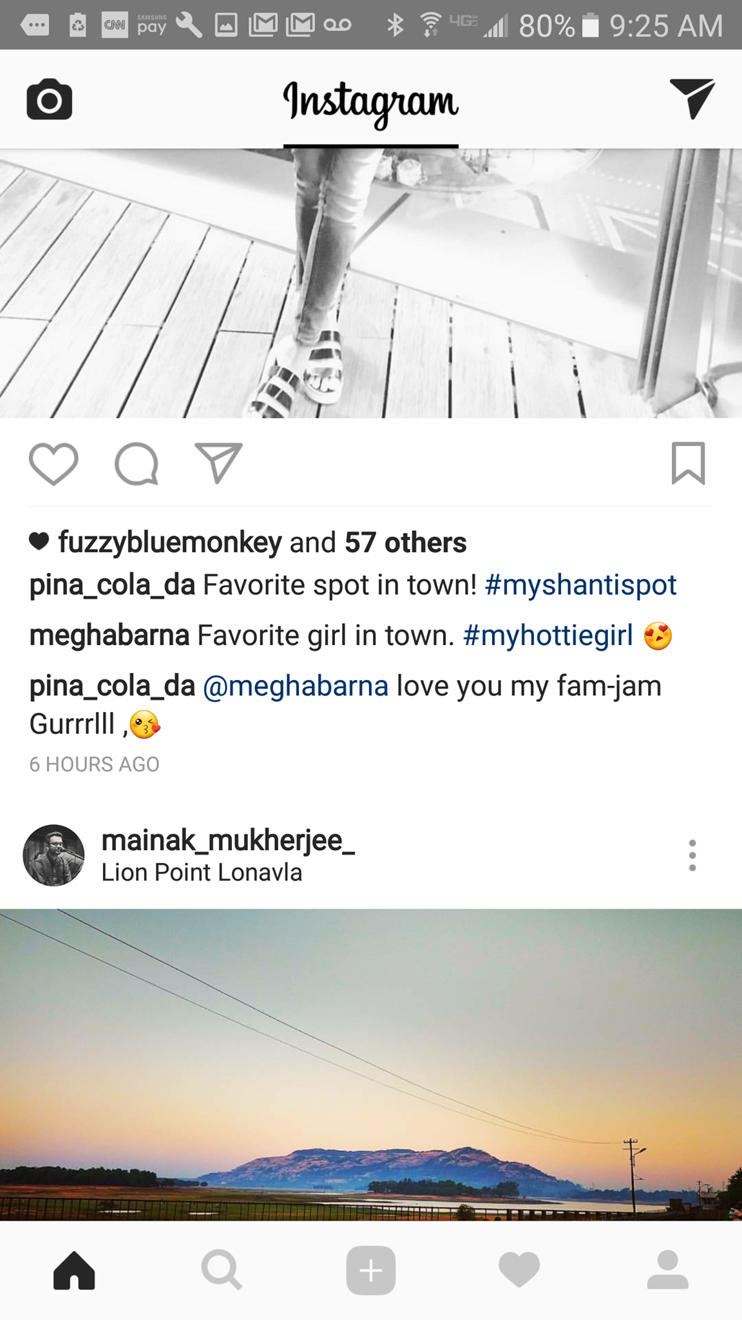
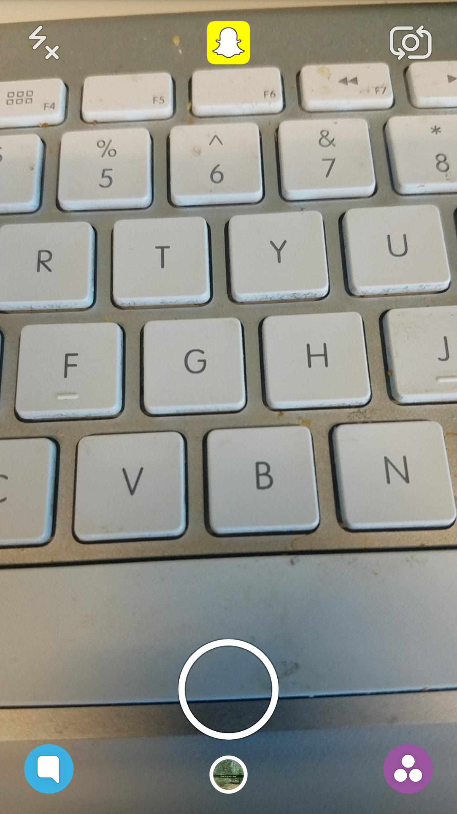
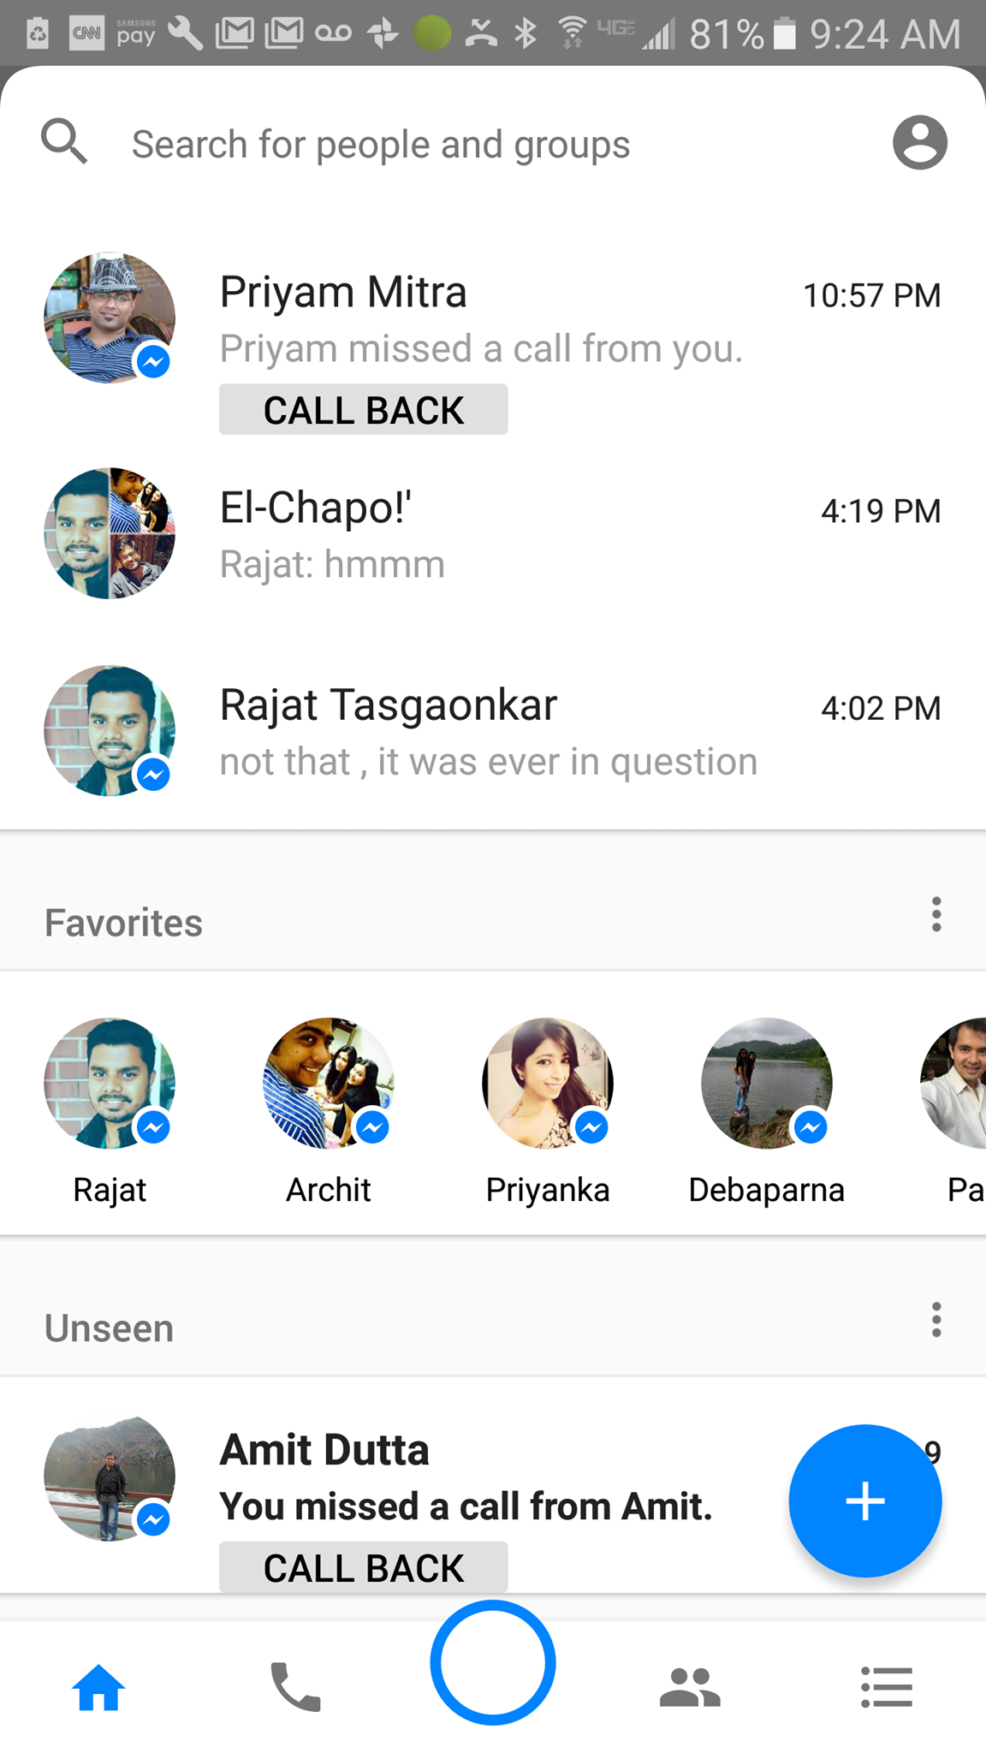
Visual communication is the heart of any social communication

Slide 4
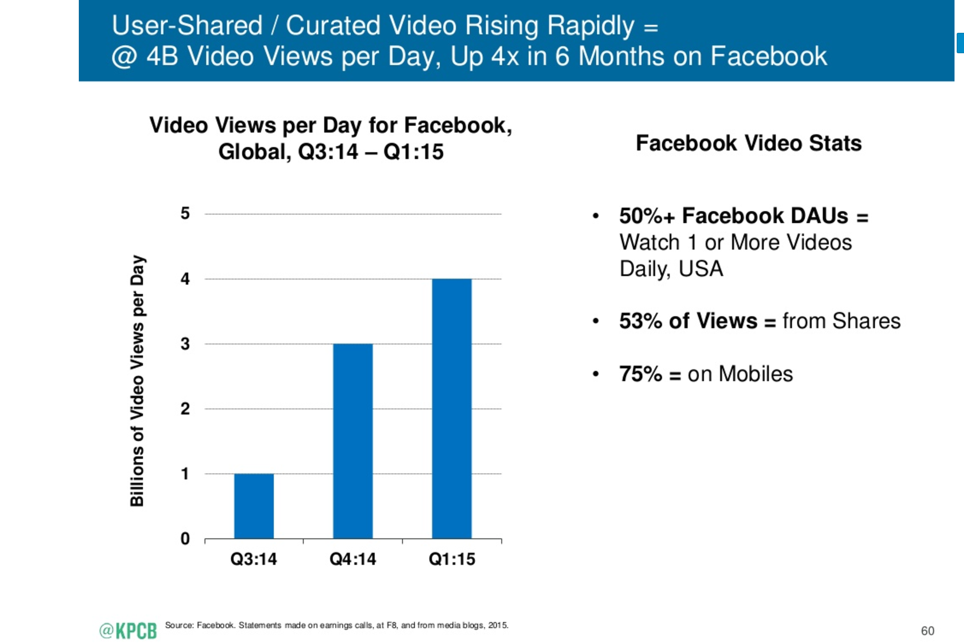
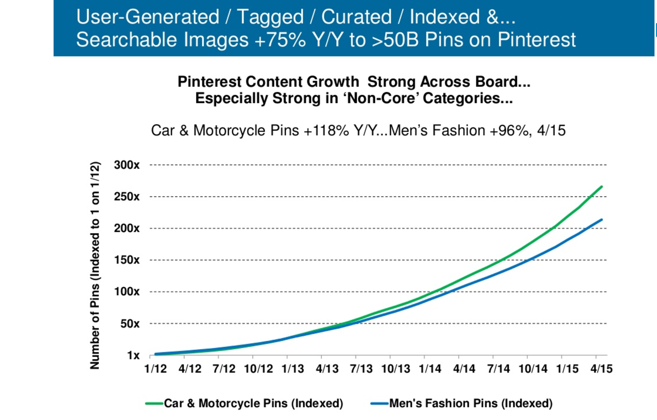
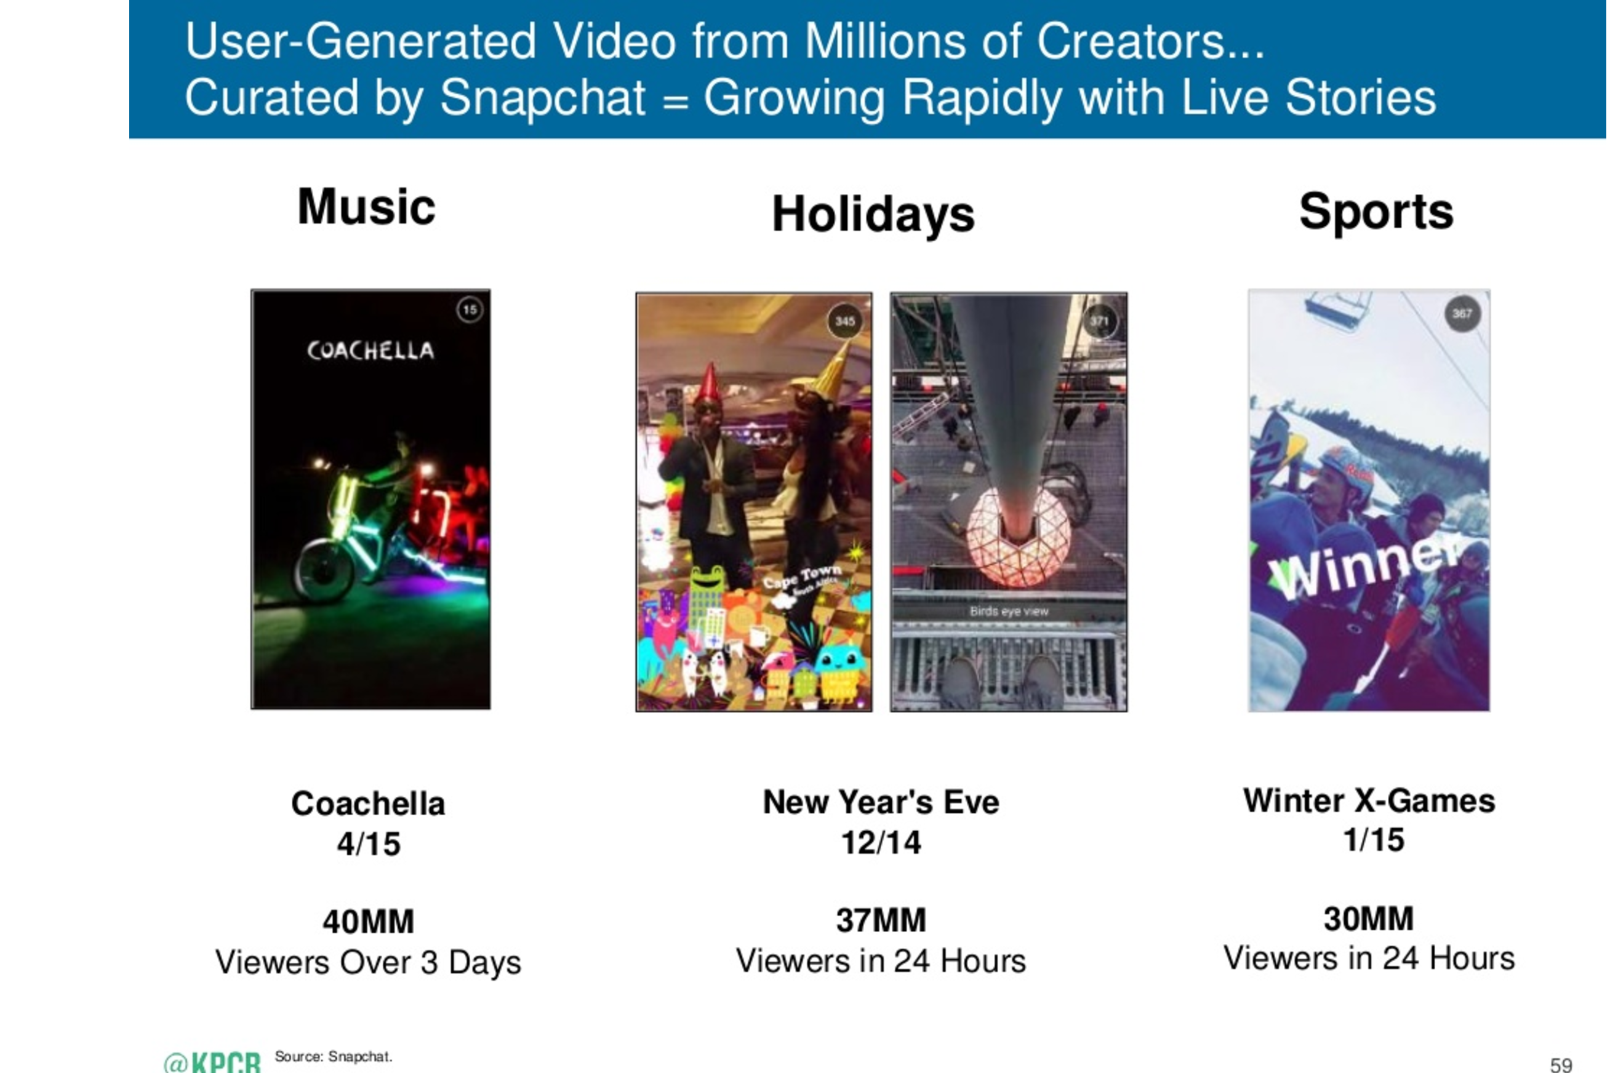
Modern technology is catching up with consumer trends
Snapshots from Mary Meeker’s 2015 Internet trends

Slide 5
The rise of visual is happening on DoubleDutch too….
92%
increase in percent of status updates which has an image from 2014 to 2016
2x
more engagement on status updates which has images than with no images

Slide 6
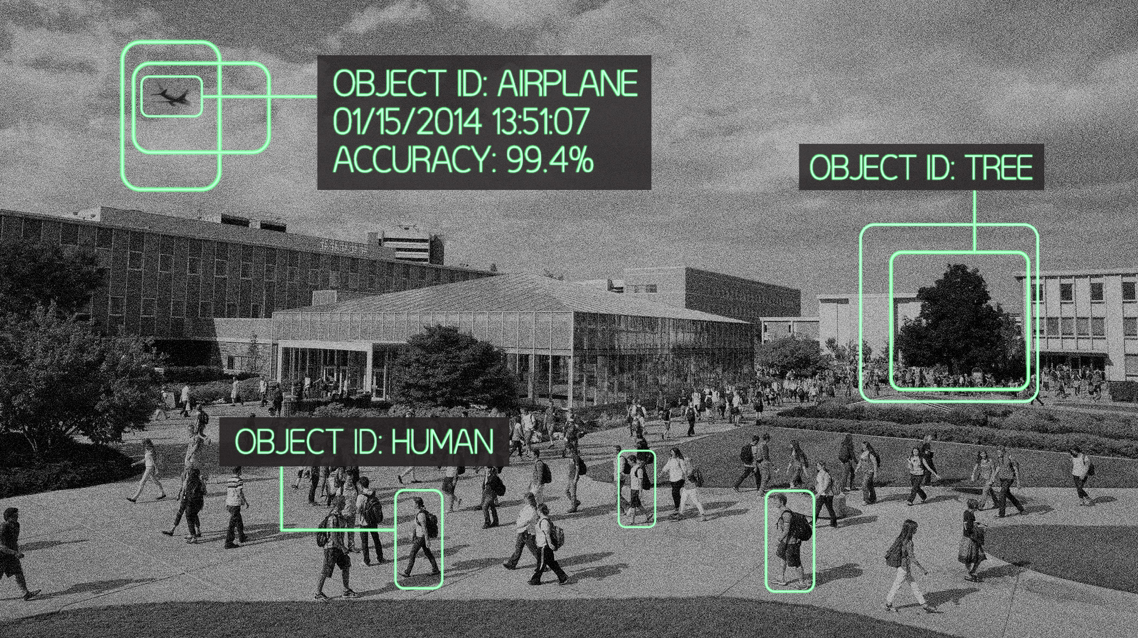
To be able to support a visual medium we need to be good at understanding images and videos

Slide 7

What did we do?

Slide 8
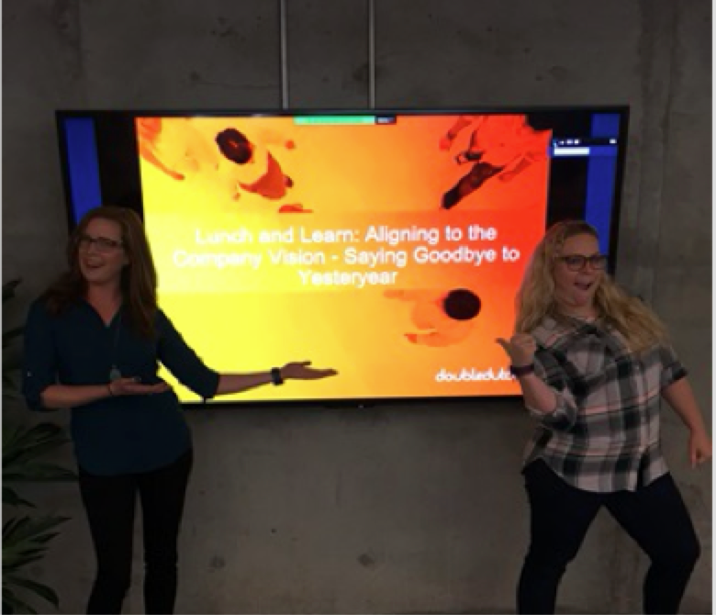
Used Google’s Vision API’s to identify attributes from images
Objects-
People
Screen
Presentation
Face attributes-
Position of eyes, lips nose etc
Expressions like joy, sorrow, anger
Readable Text-
Learn: Aligning to the Vision- Saying Goodbye to

